Slide 1
Predicting Customer Buying Patterns

Slide 2
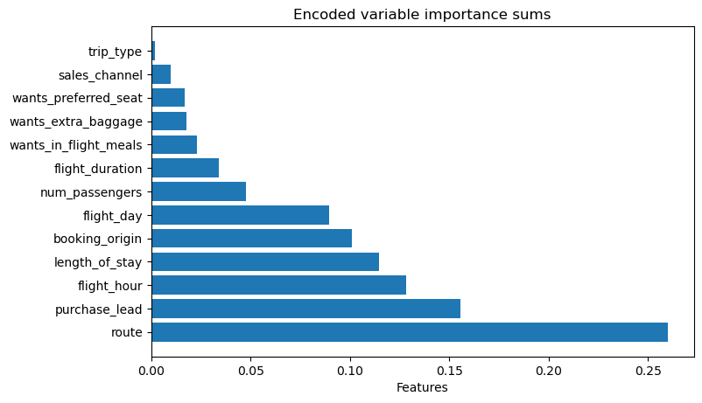
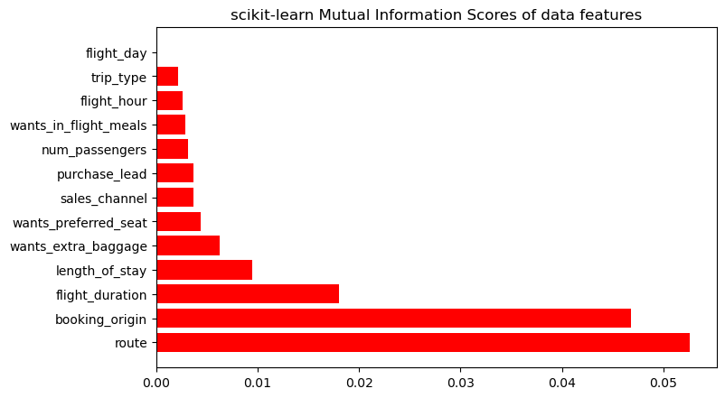
Below are the mutual information scores of the data just using scikit-learn’s built in library
The model I trained puts a lot of weight on flight hour, which doesn’t match the mutual information scores or what makes sense, so this may be a sign of overfitting
Trained Random Forest Classifier, obtaining 85.43% test accuracy
Below are the most influential features in the model’s predictive power

